Slide 1
Project and Program Monitoring

Slide 2
Programs vs Project
Program
Project
organized effort to respond to a broad social problem (typically organized at national level)
specific set of activities with linked objectives, that contribute to the overall objective of a program (typically organized at sub-national level)
Notes:
Project is a specific, time-bound initiative with clear objectives and outcomes
Program is broader and more sustained than a project. Programs are ongoing efforts designed to achieve long-term health outcomes in a population

Slide 3
Program Planning Involves
Setting goals and objectives
Identifying inputs
Identifying activities to be carried out
Stating intended Outputs
& Intended Outcomes

Slide 4
Results Chain or Logical Framework
05 Impact
04 Outcome
03 Output
02 Activities
01 Input

Slide 5

Input
Inputs are what you need to implement a program. Inputs are ‘what we use to do the work’.
e.g. Finances, personnel, equipment and other material resources –
Typically called 3Ms – Men, Money and Materials
Trained personnel
1
5
1
C&T protocols and guidelines
2
Training materials
3
4
2
HIV test kits and other supplies
4
3
Money
5

Slide 6
Activities
Activities are what you do to implement a program. ‘The processes or actions that use a range of inputs to produce the desired outputs and ultimately outcomes’
Activities describe ‘what we do’.
2
Supervision & Service provision
Recording & reporting
Curriculum, guidelines development
Counseling
Training

Slide 7
Output
‘The final products, or goods and services produced for delivery.’
Outputs describe ‘what we produce or deliver’.
Short term, immediate results
People counseled
People reached for services
Materials distributed e.g. LLITNs for malaria prevention
Clients receiving pre-test counseling, HIV tests, post-test counseling
Condoms distributed

Slide 8
Outcome
“The results of the program or changes that occur some time after activities are completed”
Changes in knowledge, behavior, attitudes and skills
Reduced risk behavior

Slide 9
Impact
Long-term effect , change or results over time
3
Decline in HIV/AIDS mortality
Decrease in HIV Incidence
1
2
Decrease in HIV transmission rate

Slide 10
So how does this relate to Monitoring and Evaluation (M&E)?

Slide 11
What do we mean by M& E
Set of procedures & analytical tools to examine
how programs are conducted (inputs & activities)
their level of performance (outputs)
whether they achieved what they were intended to achieve (outcomes & impact)

Slide 12
What is Monitoring?

Slide 13
Monitoring is:
“Ongoing process of collecting and analyzing data to measure implementation performance”
or
“Routine tracking of priority information about a program

Slide 14
What is Evaluation?

Slide 15
Evaluation is
Evaluation: “comparison of actual project outcomes and impacts against agreed strategic plans- goals, objectives, targets”
OR
“A collection of activities designed to determine the value or worth of a program or project intervention”

Slide 16
Purposes of M&E
Program Improvement: Evaluation helps us to improve existing programs
Improves Quality of services: Helps improve quality of patient care
Accountability:
Accountability may be to the funder, to the government, to the organization, to the clients, and to the community
Knowledge Development:
Evaluation helps us to plan future programs,
identify factors (individual, community, programmatic) that influence outcomes, identify best practices and methods

Slide 17
Differences Between Monitoring and Evaluation
Continuous
Periodic(baseline, mid-term and end of project)
Monitoring
Evaluation
In-depth analysis
Keeps track.
Answers what activities were implemented, and results achieved
Answers why and how results were achieved.

Slide 18
Role of Data in Public Health Program Implementation
Notes:
Data plays a fundamental role in the implementation of public health programs by providing the foundation for decision-making, monitoring progress, and evaluating outcomes. Effective use of data ensures that public health initiatives are evidence-based, targeted, and efficient. Here's a breakdown of the role of data at various stages of public health program implementation:

Slide 19
Critical Role of Data in Public Health
Program Pmplementation
Needs Assessment and Program Design
Identifying Health Priorities
Setting Program Objectives
Resource Allocation
Monitoring and Evaluation
Outcome Evaluation
Impact Evaluation
Process Evaluation
Targeting Interventions
Defining Target Populations
Geographic Targeting
Tailoring Interventions
Community Engagement and Feedback
Data for Community Needs
Real-Time Feedback
Implementation and Program Management
Tracking Program Progress
Performance Metrics
Adaptation and Continuous Improvement
Global Health and Multisectoral Collaboration
International Comparisons
Collaborative Efforts
Policy Development and Advocacy
Evidence-Based Policy Making
Advocacy for Funding and Support
Public Health Messaging
Notes:
1. Needs Assessment and Program Design
Identifying Health Priorities: Data helps in identifying public health issues, such as disease prevalence, mortality rates, or risk factors in specific populations. By analyzing demographic, epidemiological, and environmental data, public health professionals can determine the greatest needs and target areas for intervention.
Understanding Risk Factors: Data can reveal underlying social, economic, and environmental determinants of health, which helps in designing interventions that address the root causes of health issues.
Setting Program Objectives: Based on the data gathered during the needs assessment, specific, measurable, achievable, relevant, and time-bound (SMART) objectives can be defined for the program.
Resource Allocation: Data informs how resources—financial, human, and material—are allocated. For example, high-prevalence areas of certain diseases may receive more funding and staffing to address specific health challenges.
2. Targeting Interventions
Defining Target Populations: Data allows for precise identification of the populations most at risk or in need of public health interventions. This ensures that resources are directed where they will have the greatest impact.
Geographic Targeting: Geospatial data (e.g., through Geographic Information Systems - GIS) enables mapping of disease outbreaks or risk factors, allowing public health programs to concentrate efforts in specific regions.
Tailoring Interventions: Data can also help in tailoring interventions to the specific needs, behaviors, and preferences of the target population. For instance, data on health behaviors can guide the development of culturally appropriate health education materials.
3. Implementation and Program Management
Tracking Program Progress: During the implementation phase, data is used to track the progress of program activities, such as the number of people reached, services delivered, or supplies distributed.
Performance Metrics: Data on key performance indicators (KPIs) such as vaccination rates, screening coverage, or treatment adherence rates are collected to monitor the effectiveness of the interventions.
Adaptation and Continuous Improvement: Data allows public health programs to be adaptive and responsive. Real-time or periodic data collection enables program managers to identify challenges or bottlenecks early on and make adjustments to improve implementation efficiency.
4. Monitoring and Evaluation
Outcome Evaluation: Data plays a key role in assessing whether the public health program achieved its intended outcomes. For example, comparing pre- and post-intervention health indicators like reduced disease incidence, mortality rates, or improved health behaviors helps determine the program's impact.
Impact Evaluation: This involves using long-term data to assess whether the program had a broader societal impact, such as improving overall health equity or reducing health disparities.
Process Evaluation: Data helps assess how well the program was implemented, whether it was delivered as planned, and if the program reached the intended population. This evaluation can inform future public health initiatives.
6. Policy Development and Advocacy
Evidence-Based Policy Making: Data provides the evidence necessary to support policy changes, program expansions, or new health initiatives. For example, data showing high rates of childhood obesity might lead to new policies on school nutrition programs.
Advocacy for Funding and Support: Public health programs rely on data to advocate for sustained or increased funding by demonstrating measurable improvements in health outcomes or cost savings due to disease prevention.
Public Health Messaging: Data also supports the development of targeted communication strategies for public awareness campaigns. For instance, data on disease transmission patterns can guide messaging on preventive measures like vaccination or hygiene practices.
8. Community Engagement and Feedback
Data for Community Needs: Data gathered directly from communities, such as through surveys or focus groups, helps ensure that public health programs align with the specific needs and preferences of the target population.
Real-Time Feedback: By collecting and analyzing community feedback data, public health programs can stay responsive to community concerns, ensuring higher acceptance and success of the program.
9. Global Health and Multisectoral Collaboration
International Comparisons: Data allows for the comparison of health outcomes and interventions across different countries or regions, providing insights into global health trends and helping to inform best practices.
Collaborative Efforts: Public health programs often involve multisectoral collaboration (government, private sector, NGOs). Data facilitates communication, collaboration, and accountability among different stakeholders.
Conclusion

Slide 20
Patient Flow in a Facility

Slide 21
Overall On-Site patient/Data Flow
Laboratory
PMM Forms
PMTCT
HMIS
CLINIC
M & E Officer
Pharmacy
Adherence
VCT

Slide 22
National Tools and Registers (PMM and PME)

Slide 23
Training Objectives
At the end of this training session, participants will
One
Be familiar with the different PMM and PME tools
Two
Understand the source document used in filling/updating the registers
Three
Understand the importance of updating patient information on the register
Four
Understand versioning of DCTs and importance of tools review

Slide 24

Version of DCTs
One
Two
The DCTs in the HIV program is reviewed every 3 years
This review is led by NASCP in collaboration with relevant stakeholders
Who lead HIV tools review
FMoH through NASCP
Who are the major stakeholders in the HIV/AIDS space
FMoH, Funders, IPs, CBOs
Three
Four
Major stakeholders and funders are invited for the review when the versions of tools are agreed upon to capture all relevant indicators in the HIV space
The last tool review was done in 2020/2021 and NASCP has started the process of tools review which will be finalized sometime in 2025
Every three years
How often are the HIV program tools reviewed

Slide 25
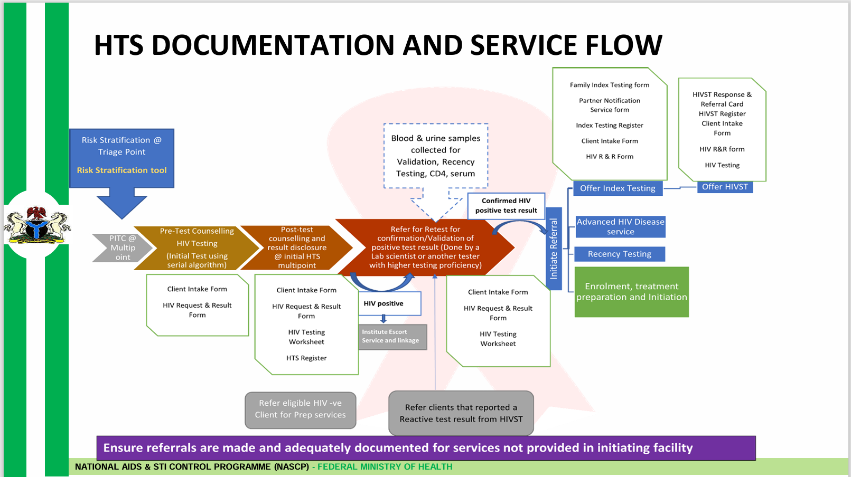

Slide 26
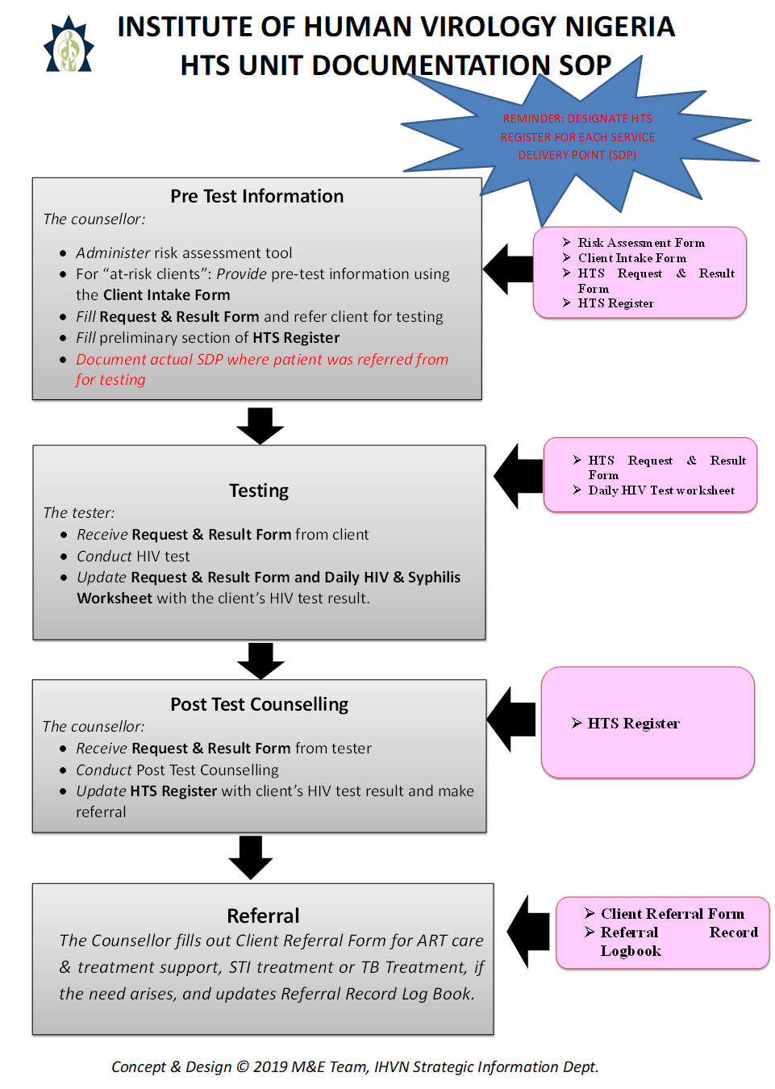

Slide 27
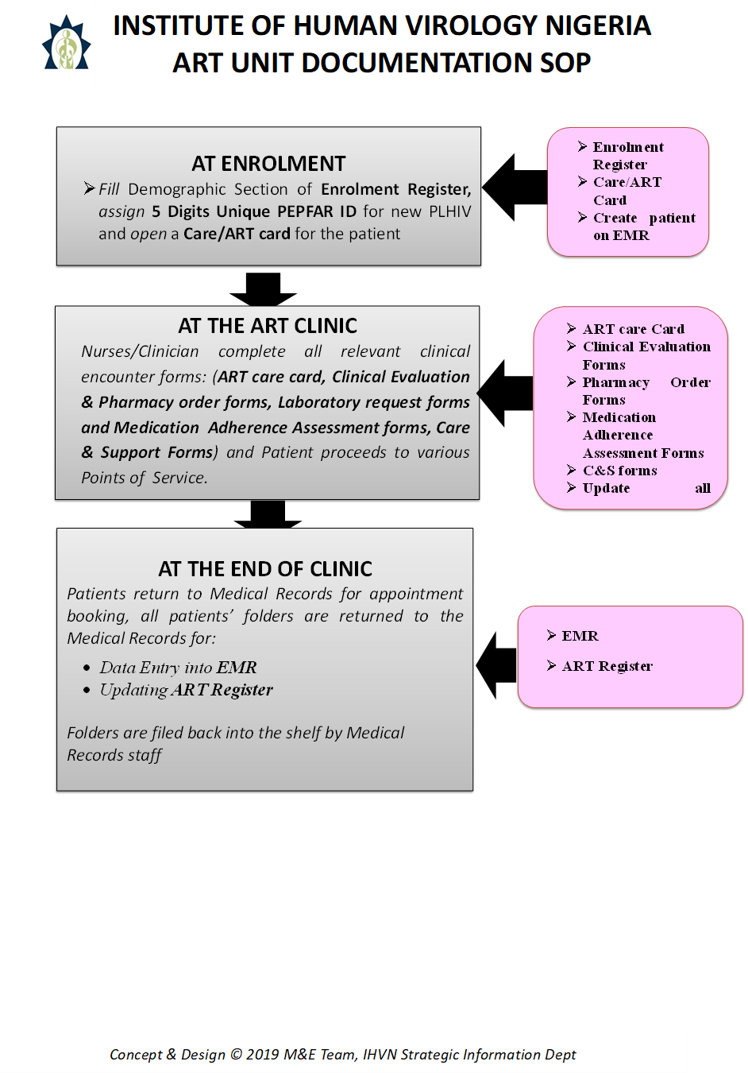

Slide 28
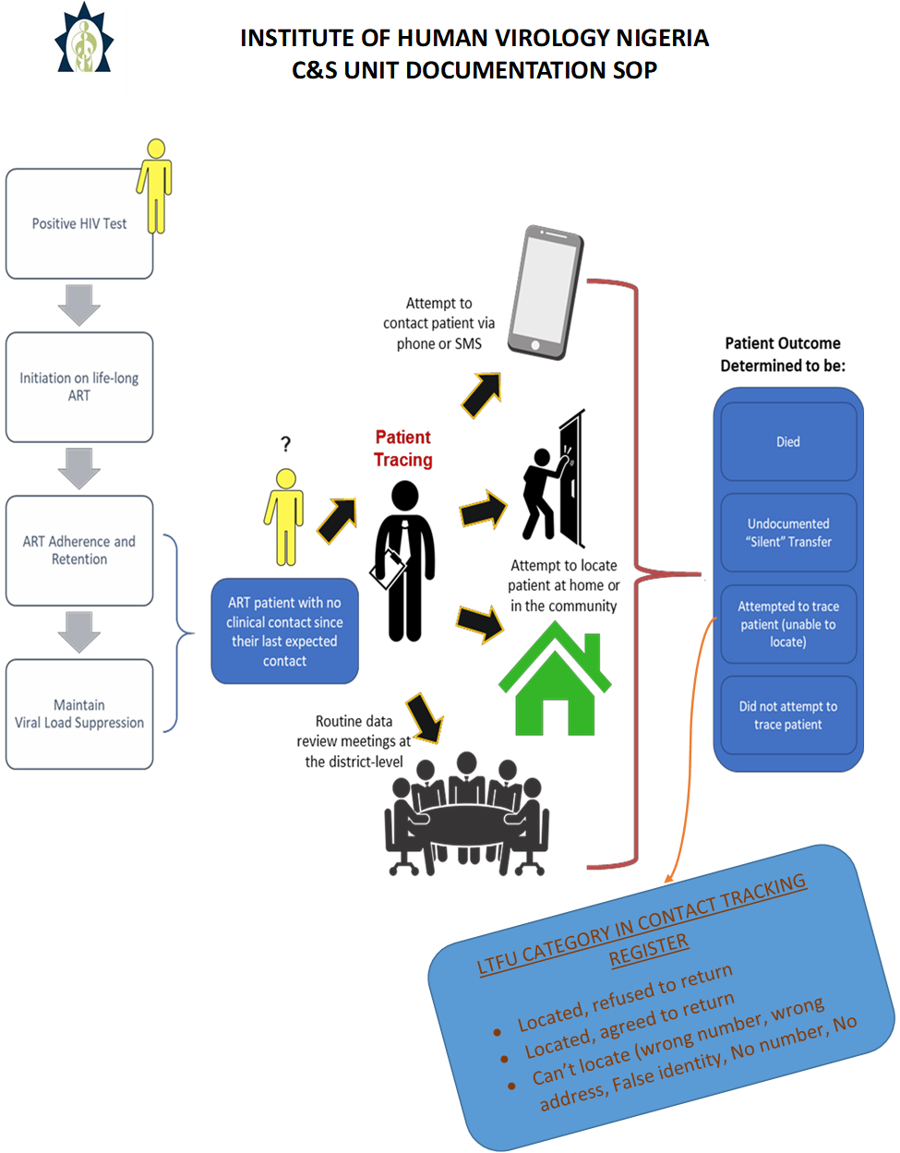

Slide 29
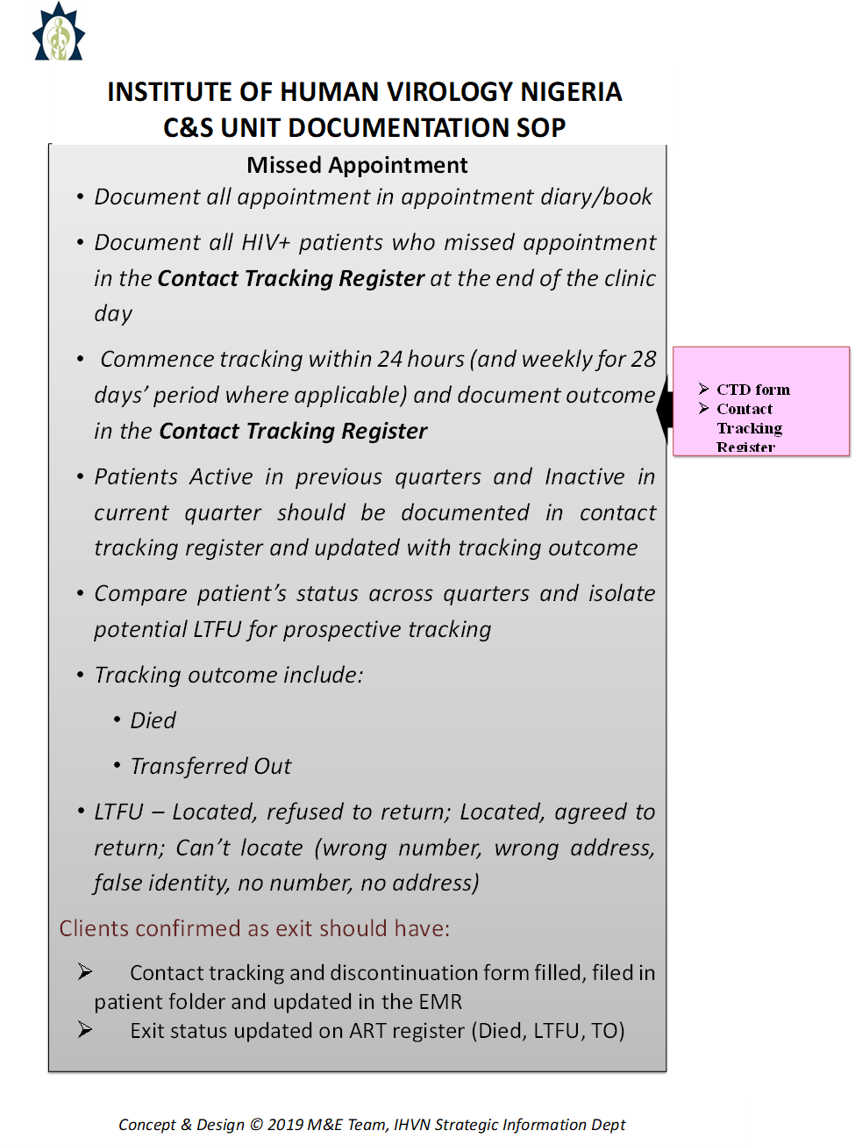

Slide 30
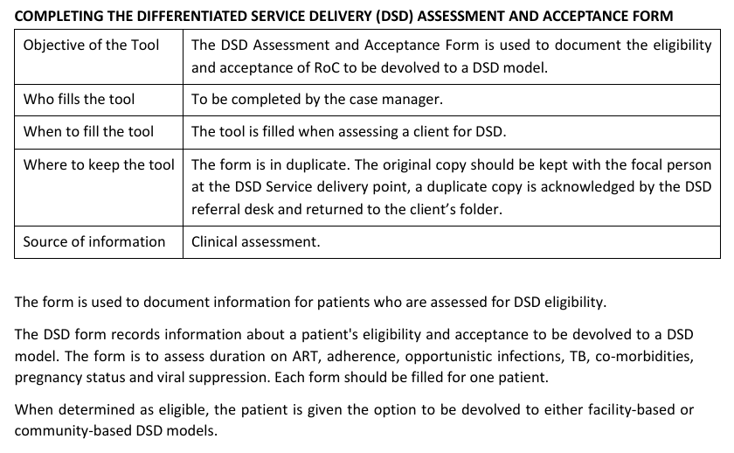
DSD Assessment and Acceptance form

Slide 31
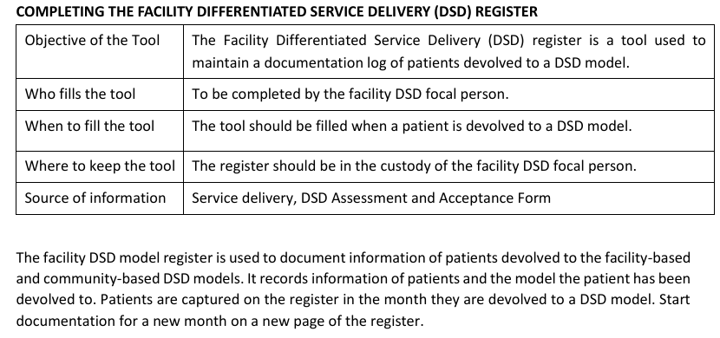
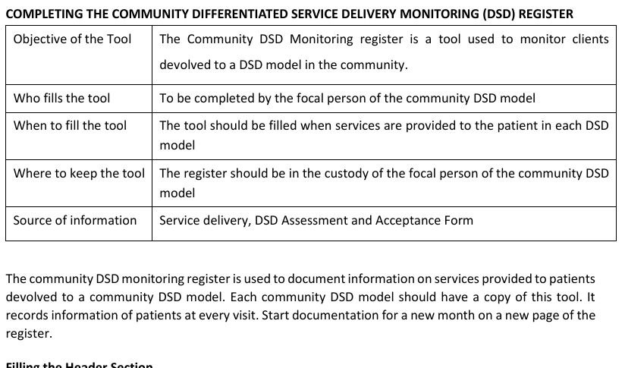
DSD Registers

Slide 32
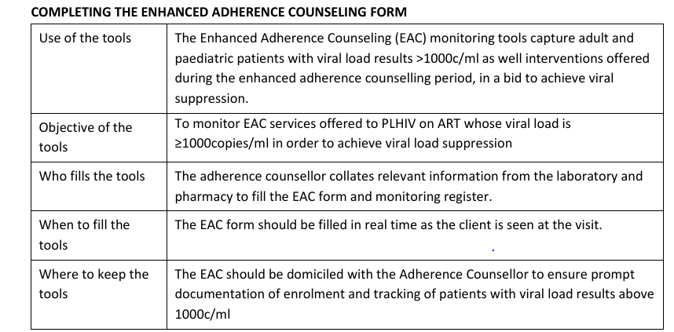
EAC Register

Slide 33
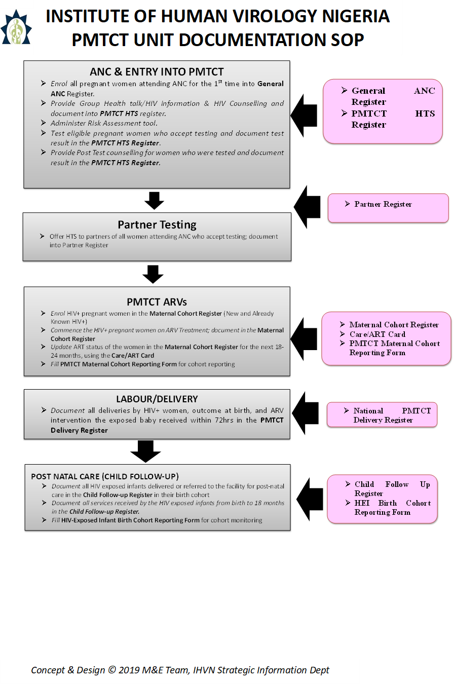

Slide 34
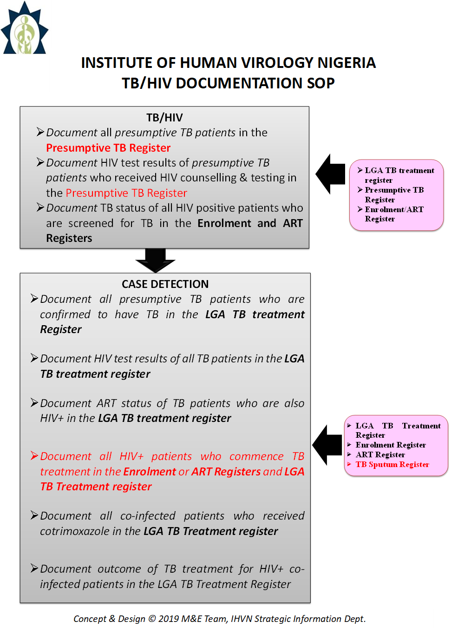

Slide 35
Benefit of proper filling of DCTs in HIV Program
The DCTs use in HIV is important, the benefits include the following:
1
3
5
Helps in improved decision-making
Resource Optimization
Increased program efficiency
Enhanced Monitoring and Evaluation
Better patient outcomes
Identification of trends and patterns
2
4
6

Slide 36
Indicators and MER

Slide 37
Overview of the MER indicator reference guide
PEPFAR supports communities and host country governments to reach the UNAIDS 95-95-95 global goals: 95 percent of people living with HIV know their HIV status, 95 percent of people who know their HIV status are accessing treatment, and 95 percent of people on treatment have suppressed viral loads.
PEPFAR MER indicators are instrumental in tracking progress towards these targets
What is MER indicator reference guide?
Monitoring, Evaluation, and Reporting (MER) indicators .
Database is a tool for exploring the impact of PEPFAR and the current state of the HIV/AIDS epidemic.
MER indicator Version
The current version in use is MER 2.0 (Version 2.7) September 2023.
PEPFAR conducts an annual review of MER indicators to ensure they align with the programs planned for implementation and expectations and reflect any new PEPFAR initiatives

Slide 38
Objectives of MER
1
2
3
Monitor Program Performance:
Collect and analyze data on key performance indicators to assess the reach, effectiveness, and efficiency of interventions.
Evaluate Impact and Effectiveness:
Assess how well programs are achieving desired health outcomes, such as reduced HIV incidence, increased viral suppression, and improved patient retention.
Ensure Accountability and Transparency:
Regularly report program performance data, ensuring transparency in how resources are used and the impact they achieve.

Slide 39
Objectives Of MER
4
5
6
Inform Decision-Making:
Use collected data to identify gaps, inform strategic planning, and allocate resources efficiently.
Support Achievement of 95-95-95 Targets:
Monitor indicators related to testing, treatment, and viral suppression.
Enhance Data Quality and Use:
Implement robust data quality assurance processes and promote the use of high-quality data for informed decision-making at all levels.

Slide 40
Key Updates and Changes: MER v2.6.1 to MER v2.7
NEW DISAGGREGATIONS:
HTS_SELF: Added optional disaggregate under disaggregate group “Unassisted self-testing” to report “Caretaker for
Child.”
PrEP_NEW: Added required disaggregate group for “PrEP Type.” Added optional disaggregate group for PrEP distribution.
Add optional disaggregate group for “Pregnancy/breastfeeding status.”
PrEP_CT: Added required disaggregate group for “PrEP Type.” Added optional disaggregate group for PrEP distribution.
HTS_TST: Split PostANC 1 modality into two modalities with fine age bands to include Post ANC1 Pregnant and L&D Post
ANC1 Breastfeeding.
TB_STAT: Added disaggregate on “recent negatives.”
OVC_HIVSTAT: Added 18-20 age band to OVC_HIVSTAT.
TX_NEW: Added new CD4 disaggregate group.
TX_RTT: Added new CD4 disaggregate group.
PMTCT_EID: Added new disaggregate for multiple virological HIV tests of HEI.
PMTCT_HEI: Add virological HIV test result retuned disaggregates.
TX_TB: Moving from coarse to fine age bands up to 65+. Added screening type disaggregate.
LAB_PTCQI: Added test type category for “TB LF-LAM.”

Slide 41
Indicator Definition Clarifications
CXCA_SCRN: Added minor clarifying guidance disaggregate definitions for CXCA_SCRN_POS.
HTS_TST: Clarified that HTS provided to individuals with presumptive TB should be reported under OtherPITC and not under TB_STAT;
Clarified guidance for how to report HTS if an implementing partner does not report on all testing modalities
KP_PREV: Updated definition to require distribution of condoms, lubricant, and offer or referral to PrEP to count an individual under KP_PREV;
Updated definition to include giving the option of distributing an HIV self-test as an alternative to traditional HTS;
Updated numerator and denominator to include primary or secondary interventions designed for intended key population;
Updated definition to include reaching number of KPs at least once during reporting period.
OVC_SERV: Clarified guidance around Peace Corps Volunteer OVC Preventive activities in indicator reference sheet and
Appendix F.
PP_PREV: Updated definition to include giving the option of distributing an HIV self-test as an alternative to traditional
HTS.
TX_TB: Clarified definitions of TB screen result by screening type.

Slide 42
Retired Disaggregations/Indicators
LAB_PTCQI: Reduce the number of disaggregates by condensing Lab/CQI and Lab/PT into one disaggregate with 4 categories; Condense POCT/CQI and POCT/PT into one disaggregate with 4 categories
TX_PVLS: Remove disaggregate from TX_PVLS for targeted and routine viral load testing.
EMR_SITE: Retired; information on EMRs will move to site attributes.
FPINT_SITE Retired.

Slide 43
Indicator Measurement, Frequence and Reporting Cycle

Slide 44
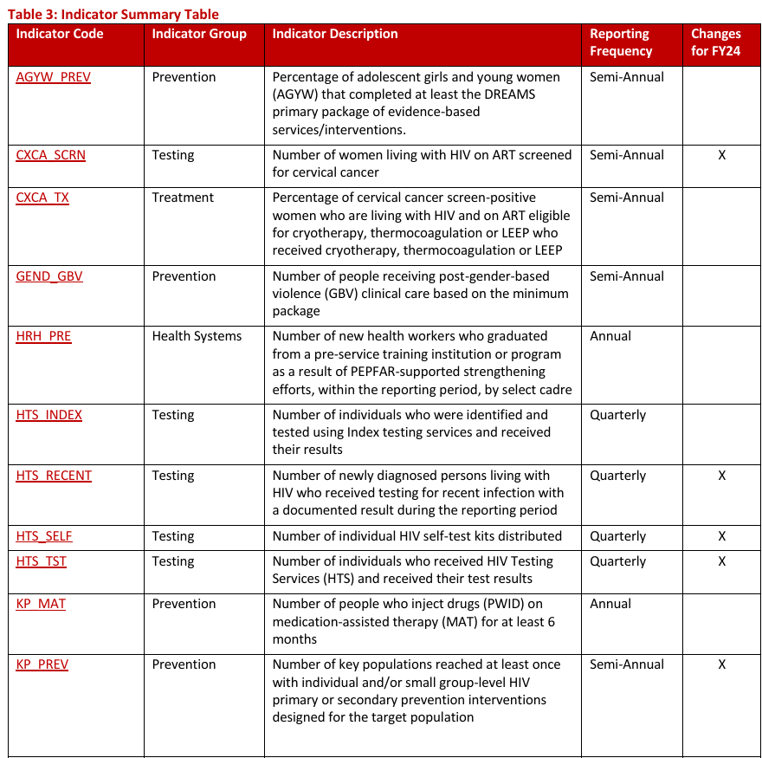

Slide 45
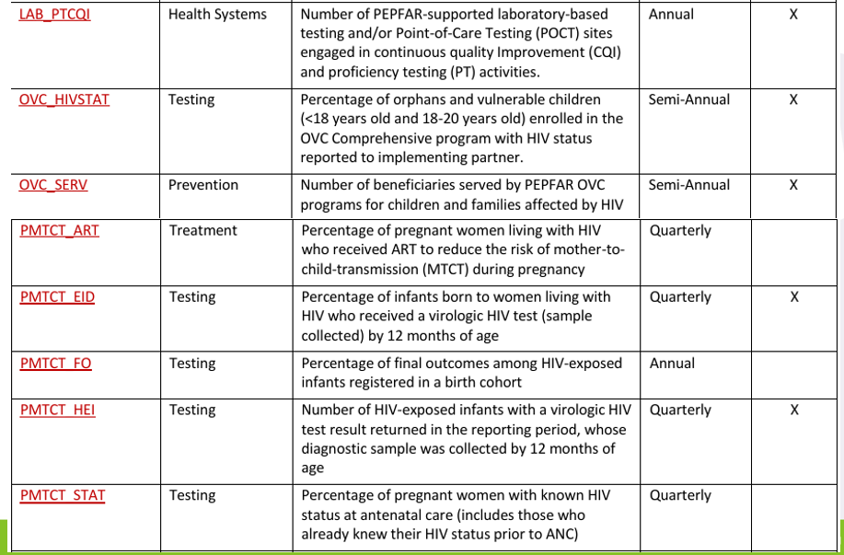

Slide 46
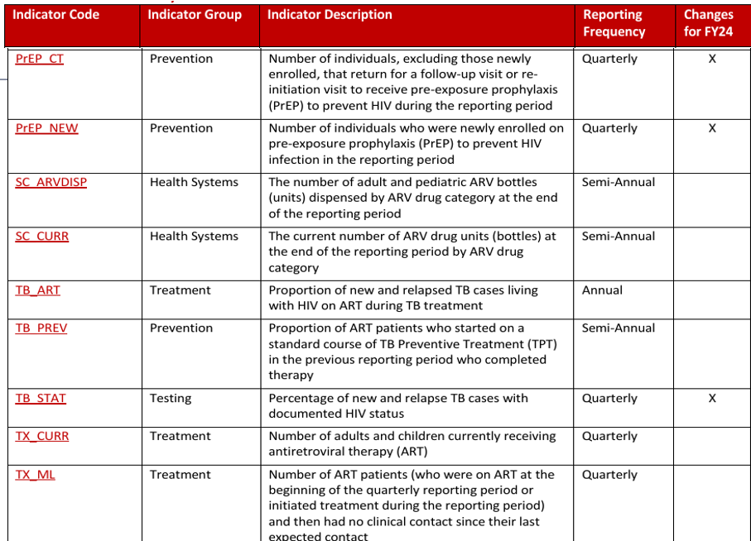

Slide 47
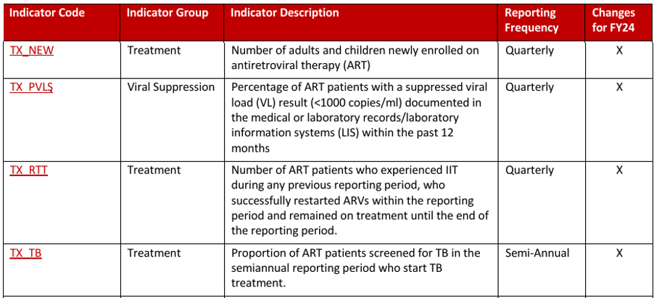

Slide 48
Cascades (ART, PMTCT, HTS, TB)

Slide 49

HTS Cascade & Key Indicators

Slide 50
What is HTS?
HIV Testing Services (HTS) refers to the full range of services that should be provided together with HIV testing – counselling, linkage to appropriate HIV prevention, treatment and care services and other clinical and support services; and coordination with laboratory services to support quality assurance and the delivery of correct
Notes:
HTS is critical to the HIV program. It is the entry point for HIV prevention, treatment, care, and support services

Slide 51

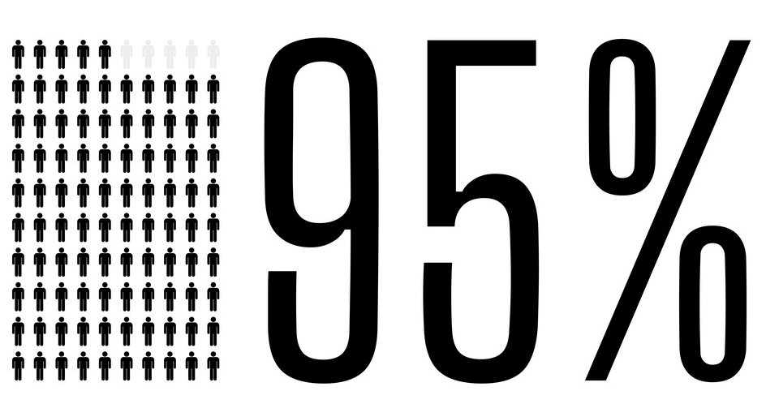

HTS 95 Target
Of people living with HIV (PLHIV) know their HIV status by 2030
First step in attaining the UNAIDS goal of achieving HIV epidemic control by 2030
Critical entry point for the HIV prevention, care and treatment services

Slide 52
Guiding Principles of HTS: The 5Cs
HTS should be delivered using a client-centered approach guided by WHO’s 5 core principles
Consent
Confidentiality
Connection to appropriate services (prevention, treatment, care, & support services)
Counselling
Correct test result

Slide 53
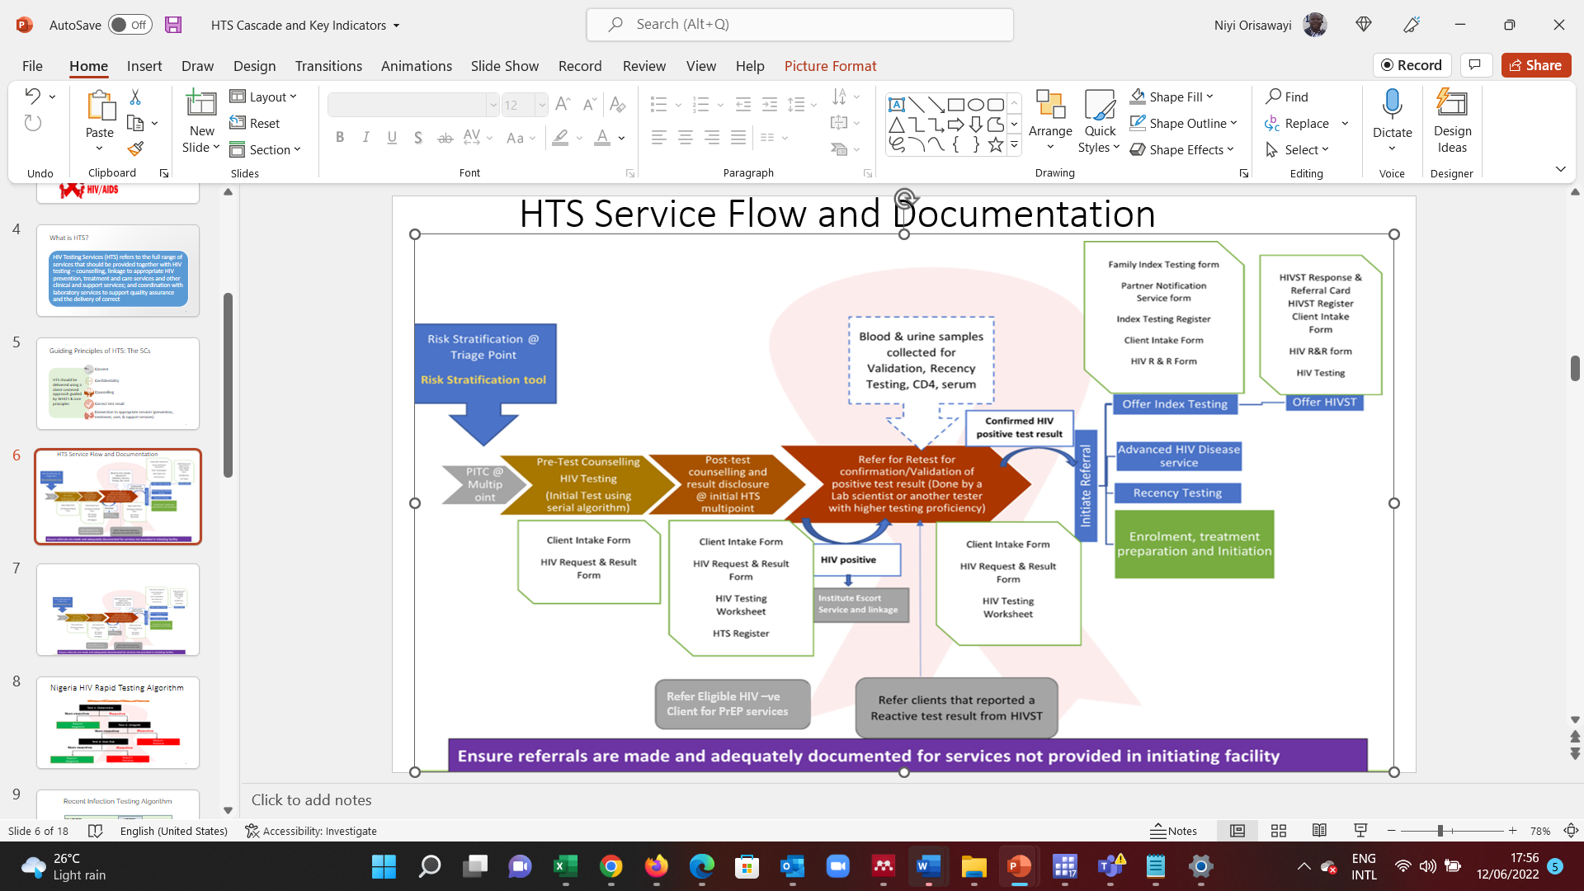
HTS Service Flow and Documentation
Refer Eligible HIV –ve Client for PrEP services

Slide 54
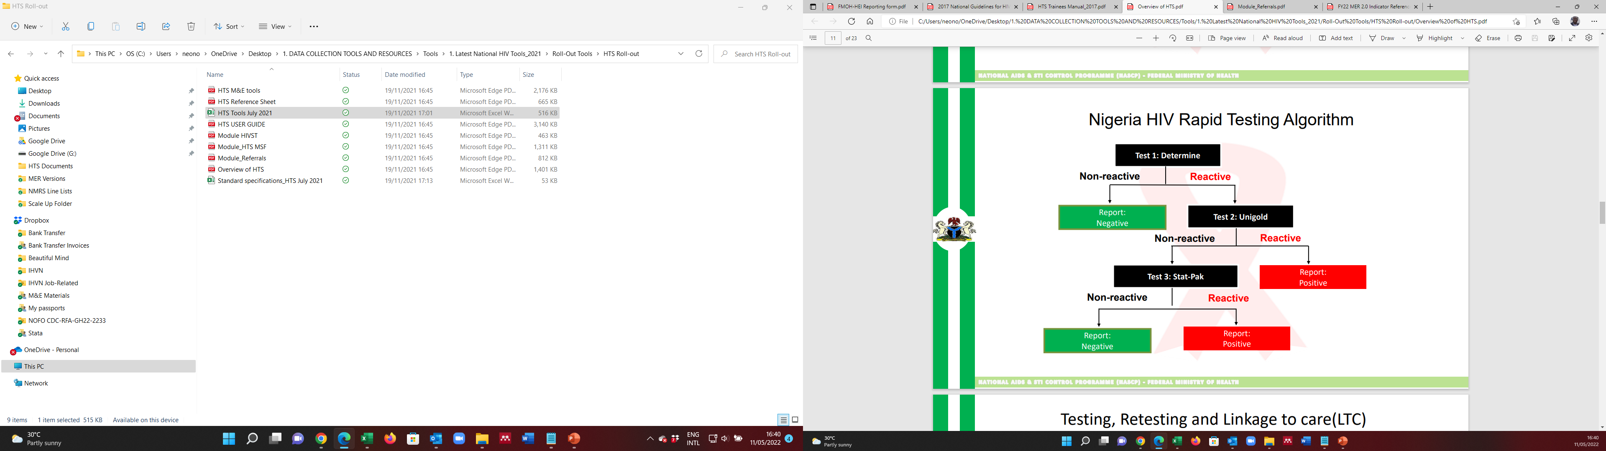
Nigeria HIV Rapid Testing Algorithm

Slide 55
Recent Infection Testing Algorithm
Recency testing helps to estimate the duration of HIV infection in newly diagnosed, ARV-naive PLIHIV ≥15 years and give an idea of the incidence of HIV infection in a population
HIV Test using
National Algorithm
Determine Reactive
Rapid Test For Recent
Infection (RTRI) Result
Recent
Long-term
Negative
Invalid
Viral Load
Testing
≥ 1000 copies/ml
< 1000 copies/ml
Final
Recency Result
RITA Recent
RITA Long Term
(Reclassified)

Slide 56
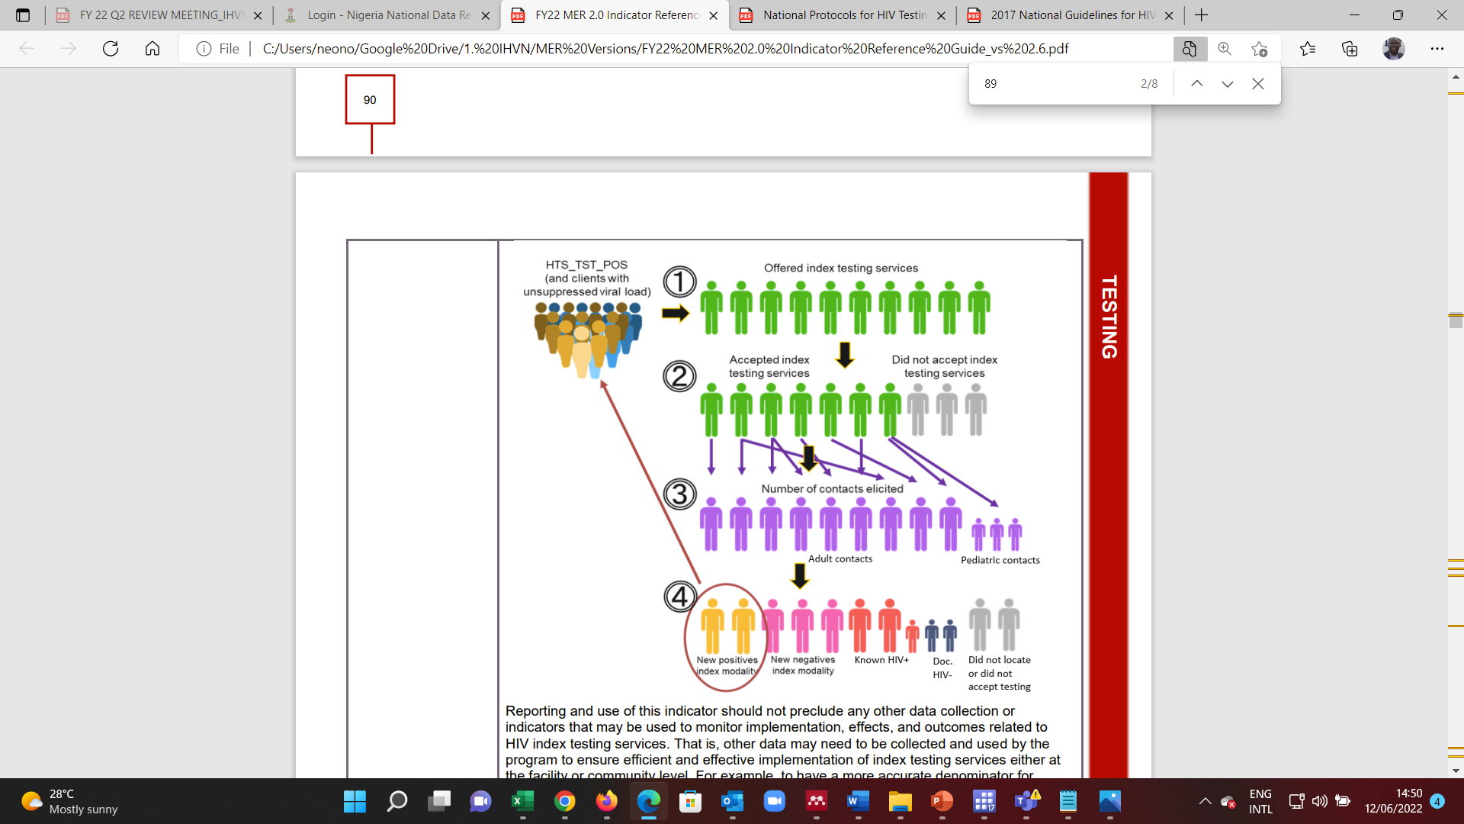
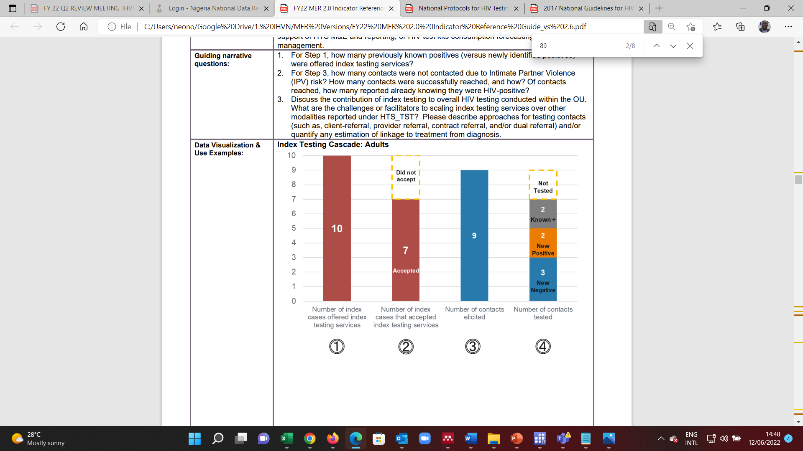
Index Testing Cascade
Index testing is an approach whereby an exposed contacts of an HIV positive person (index case) are elicited and offered HIV testing services. The contacts can be sexual, biological (child/parent), or needle sharing contacts.

Slide 57
MER Indicators: HTS_TST
Definition
Number of individuals who received HIV Testing Services (HTS) and received their test results
Modalities
Facility: Emergency, inpatient ward, Pediatrics (<5 clinic), TB, STI, Index, PMTCT (ANC-1), PMTCT (Post-ANC1: Pregnancy/L&D/BF), malnutrition, Other PITC, VCT
Community: Mobile, Index, Other community modalities
Disaggregation: Modality & Result by age & sex, key population type
Reporting frequency: Quarterly
Reporting level: facility and community
Data Source: Client Intake Form, HTS Register, PMTCT HTS Register

Slide 58
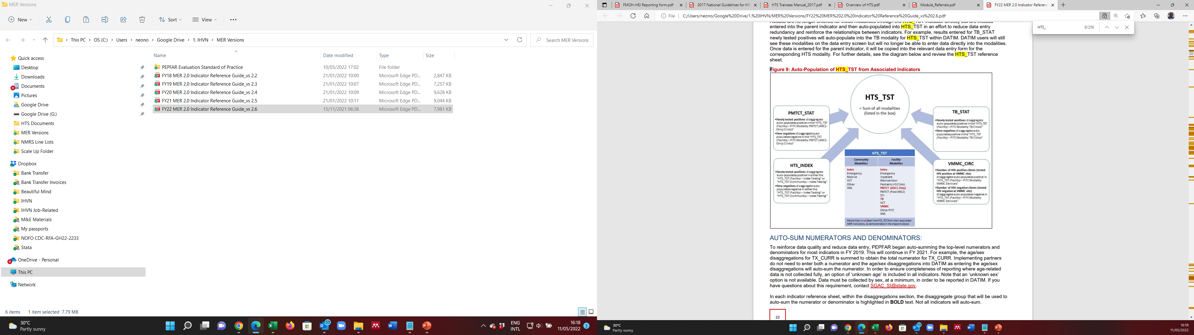
MER Indicators: HTS_TST (2)

Slide 59
MER Indicators: HTS_INDEX
Definition
Number of individuals who were identified and tested using Index testing services and received their results
Disaggregation
Number of index cases offered index testing by age/sex
Number of index cases that accepted index testing by age/sex
Number of contacts elicited by age/sex
Number of contacts tested & results by age/sex
Reporting Frequency: Quarterly
Reporting Level: Facility and Community
Data Sources: Client Intake Form, Index Testing Register

Slide 60
MER Indicators: HTS_RECENT
Definition
Number of newly diagnosed HIV-positive persons who received testing for recent infection with a documented result during the reporting period
Modalities
Facility: Emergency, inpatient ward, Pediatrics (<5 clinic), TB, STI, Index, PMTCT (ANC-1), PMTCT (Post-ANC1: Pregnancy/L&D/BF), malnutrition, Other PITC, VCT
Community: Mobile, Index, Other community modalities
Disaggregation: Modality & Result by age & sex, Key population type
Reporting frequency: Quarterly
Reporting level: facility and community
Data Sources: Client Intake Form, Standalone Recency Form(NMRS), RTRI Result Documentation Form

Slide 61
MER Indicators: HTS_SELF
Definition: Number of individual HIV self-test (HIVST) kits distributed
*HIV self testing is a screening test in which a person collects his or her own specimen (oral fluid or blood), performs an HIV test using and interprets the result. Can be directly assisted or unassisted
Modalities
Facility: Emergency, inpatient ward, Pediatrics (<5 clinic), TB, STI, Index, PMTCT (ANC-1), PMTCT (Post-ANC1: Pregnancy/L&D/BF), malnutrition, Other PITC, VCT
Community: Mobile, Index, Other community modalities
Disaggregation: Type of self-testing (directly-assisted/unassisted); Number of self-test kits distributed to a person by age & sex (directly assisted. Optional for unassisted), number of self-test kits distributed by Key population type, number of self-test kits distributed for use by (self, sex partner, others)
Reporting frequency: Quarterly
Reporting level: facility and community
Data Sources: HIVST Response & Referral Card (completed for each kit distributed); HIVST Register

Slide 62

Summary of HTS M&E Tools
Client Intake Form
HIV Request and Result Form
Daily HIV & Syphilis Testing Worksheet
HTS Register
Client Referral Form
Referral Register
Partner Notification Service Form
Family Index Testing Form
Index Testing Register
HIVST Response and Referral Card
HIVST Register
HTS Monthly Summary Form
RTRI Result Documentation Form
PMTCT HTS Register

Slide 63
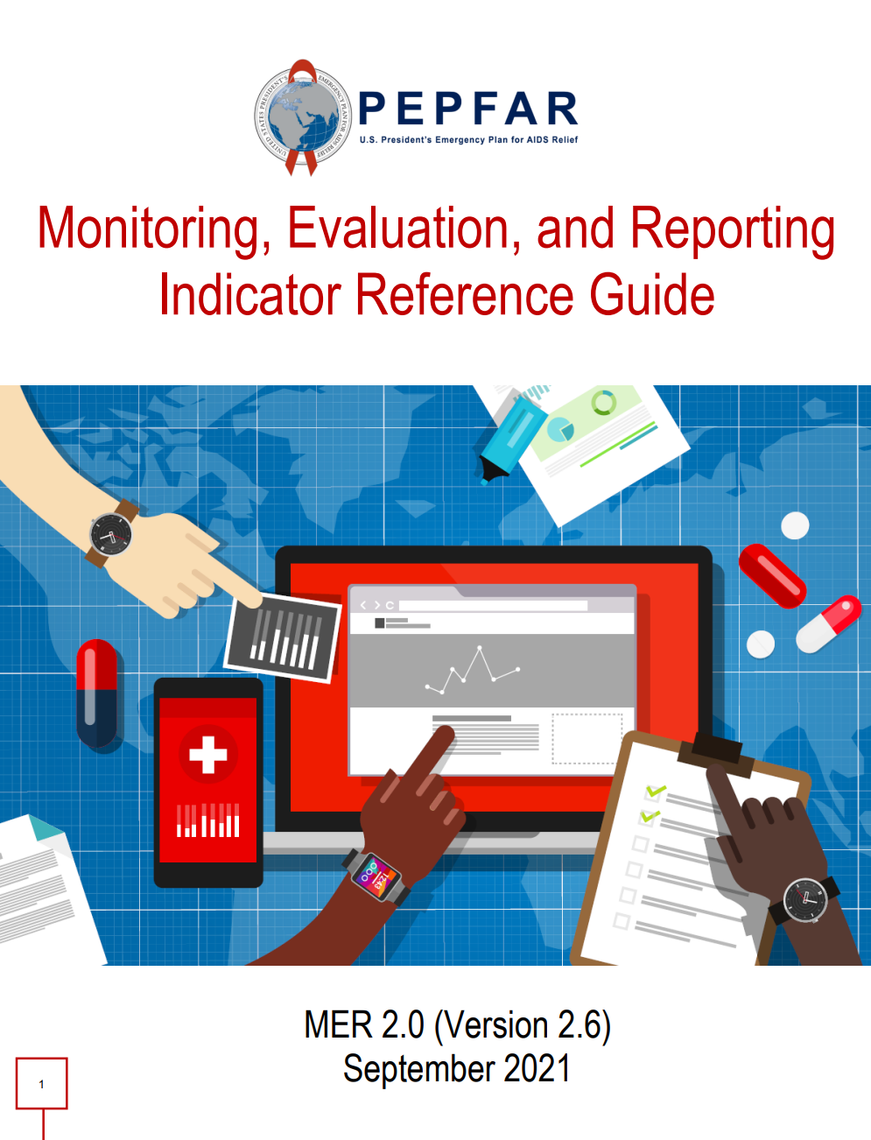
ART CASCADE & KEY INDICATORS
New Staff Orientation Online Bootcamp
14th June, 2022

Slide 64
TX_NEW
DESCRIPTION
NUMERATOR
DATA SOURCE
Number of adults and children newly enrolled on antiretroviral therapy (ART)
Number of adults and children newly enrolled on antiretroviral therapy (ART)
National Data Repository (NDR)
NigeriaMRS
ART Register
64

Slide 65
TX_NEW
COLLECTION/
REPORTING
DATA QUALITY
DISAGGREGATION
Newly enrolled in ART
Not transferred in or temporarily stopped and resumed
Numerator ≥ subtotal of each disaggregation
Confirm that TX_NEW ≤ TX_CURR
5-year Age Band
Sex
Breastfeeding Status
Key Population Type
Quarterly
65

Slide 66
TX_CURR
DESCRIPTION
NUMERATOR
DATA SOURCE
Number of adults and children currently receiving antiretroviral therapy (ART)
Number of adults and children currently receiving antiretroviral therapy (ART)
National Data Repository (NDR)
NigeriaMRS
66

Slide 67
TX_CURR
COLLECTION/
REPORTING
DATA QUALITY
DISAGGREGATION
Be on ART at the end of the reporting period
New on ART or transferred-in
Exclude patients who died, stopped treatment, transferred out, or experienced interruption in treatment (IIT).
Confirm that TX_CURR ≥ TX_NEW.
Confirm that TX_CURR ≥ TX_RTT.
Confirm that TX_CURR ≥ sub-total of each disaggregation.
5-year Age Band
Sex
Key Population Type
ARV Dispensing Quantity (<3, 3-5, ≥6 months)
Quarterly
67

Slide 68
TX_NET_NEW
DEFINITION
CALCULATION
EXAMPLE
TX_CURR (FY22 Q2):
FCT – 86,976
Katsina – 14,563
Nasarawa – 75,892
Rivers – 185,363
TX_CURR (FY22 Q1):
FCT – 83,923
Katsina – 13,884
Nasarawa – 73,667
Rivers – 179,434
The quarterly net increase or decrease in ART patients
Current Quarter TX_CURR – Past Quarter TX_CURR
TX_NET_NEW (FY22 Q2):
FCT – 3,053
Katsina - 679
Nasarawa - 2,225
Rivers – 5,929
68

Slide 69
CONTINUITY OF TREATMENT
DEFINITION
CALCULATION
EXAMPLE
TX_CURR (FY22 Q2):
FCT – 86,976
Katsina – 14,563
Nasarawa – 75,892
Rivers – 185,363
TX_CURR (FY22 Q1):
FCT – 83,923 + 2600
Katsina - 13,884 + 855
Nasarawa - 73,667 + 2,093
Rivers 179,434 + 6,243
A measure of the overall gain or loss in patients compared to the expected number of patients on treatment
Current Quarter TX_CURR / Past Quarter TX_CURR + Current Quarter TX_NEW *100
CONTINUITY OF TREATMENT (FY22 Q2):
FCT – 100%
Katsina – 99%
Nasarawa – 100%
Rivers – 100%
69

Slide 70
TX_ML
DESCRIPTION
NUMERATOR
DATA SOURCE
Number of ART patients (who were on ART at the beginning of the quarterly reporting period or initiated treatment during the reporting period) and then had no clinical contact since their last expected contact
Number of ART patients (currently on ART or newly initiating ART) with no clinical contact or ARV pick-up for > 28 days since their last expected clinical contact or ARV pick-up
National Data Repository (NDR)
NigeriaMRS
70

Slide 71
TX_ML
COLLECTION/
REPORTING
DATA QUALITY
DISAGGREGATION
Be part of TX_CURR at the beginning of the reporting period
Had no clinical contact since their last expected contact
Px that have died, Interruption in treatment (IIT) (on treatment for <3 months when experienced IIT or on treatment for ≥3 months when experienced IIT), Transferred out or Refused (stopped) treatment
5-year Age Band
Sex
Outcome (Died, Transferred Out, Interruption in treatment, Stopped
Cause of Death
N/A
Quarterly
71

Slide 72
TX_RTT
DESCRIPTION
NUMERATOR
DATA SOURCE
Number of ART patients who experienced an interruption in treatment (IIT) during any previous reporting period, who successfully restarted ARVs within the reporting period and remained on treatment until the end of the reporting period
Number of ART patients who experienced IIT during any previous reporting period, who successfully restarted ARVs within the reporting period and remained on treatment until the end of the reporting period
National Data Repository (NDR)
NigeriaMRS
72

Slide 73
TX_RTT
COLLECTION/
REPORTING
DATA QUALITY
DISAGGREGATION
In the reporting period:
Not new on ART
Be counted in TX_RTT and TX_CURR
Not counted as TX_ML
Not part of TX_CURR at the beginning of the reporting period
Confirm that TX_CURR ≥ TX_RTT
5-year Age Band
Sex
Key Population Type
Quarterly
73

Slide 74
TX_TB
DENOMINATOR/
NUMERATOR
DESCRIPTION
DATA SOURCE
Denominator:
Number of ART patients who were screened for TB at least once during the semiannual reporting period
Proportion of ART patients screened for TB in the semiannual reporting period who start TB treatment
National Data Repository (NDR)
NigeriaMRS
PLHIV Presumptive TB diagnostic evaluation and treatment register
Numerator:
Number of ART patients who were screened for TB and diagnosed with TB and
started on anti-TB therapy during the
reporting period
74

Slide 75
TX_TB
COLLECTION/
REPORTING
DATA QUALITY
DISAGGREGATION
Denominator:
Age: <15, ≥15
Sex
Screen Result
Start of ART
Numerator:
Age: <15, ≥15
Sex
ART Status
Specimen Sent (Diagnostic Test)
Positive Result Returned
On ART
Screened for TB symptoms at least once
Numerator ≥ subtotal of each of the disaggregation
Diagnosed with TB
Started on anti-TB therapy
Semi-Annual
75

Slide 76
TX_PVLS
DENOMINATOR/
NUMERATOR
DESCRIPTION
DATA SOURCE
Denominator:
Number of active ART patients with a documented VL result (TX_PVLS_DEN)
Percentage of active ART patients with a documented suppressed viral load (VL) result (<1000 copies/ml) within the past 12 months
National Data Repository (NDR)
NigeriaMRS
Numerator:
Number of active ART patients with suppressed VL results (<1,000 copies/ml) (TX_PVLS_NUM)
76

Slide 77
TX_PVLS
COLLECTION/
REPORTING
DATA QUALITY
DISAGGREGATION
Denominator:
5-year Age Band
Sex
Indication (Routine/Targeted)
Pregnant or BF
Key Population
Numerator:
5-year Age Band
Sex
Indication (Routine/Targeted)
Pregnant or BF
Key Population
Denominator:
Active on ART
On ART for ≥3 months
Have a documented viral load result
Denominator ≥ Numerator
Numerator ≥ subtotal of each of the disaggregation
TX_CURR ≥ TX_PVLS_DEN
Numerator:
Suppressed viral load result
Report the most recent result.
On ART for ≥3 months
Quarterly
77

Slide 78
VIRAL LOAD TEST COVERAGE
DENOMINATOR/
NUMERATOR
DESCRIPTION
EXAMPLE
TX_PVLS (FY22 Q2):
FCT – 71,314
Katsina – 10,759
Nasarawa – 61,062
Rivers – 163,666
TX_CURR (FY21 Q4):
FCT – 81,898
Katsina-12,762
Nasarawa –72,075
Rivers – 173,392
Denominator:
TX_CURR from 2 quarters prior)
Percentage of patients eligible for viral load testing who have received a viral load test
Numerator:
Current TX_PVLS_DEN
Coverage (FY22 Q2):
FCT – 87%
Katsina – 84%
Nasarawa – 85%
Rivers – 94%
78

Slide 79
VIRAL SUPPRESSION
DESCRIPTION
DENOMINATOR/
NUMERATOR
EXAMPLE
TX_PVLS_DEN (FY22 Q2):
FCT – 71,314
Katsina – 10,759
Nasarawa – 61,062
Rivers – 163,666
TX_PVLS_NUM (FY22 Q2):
FCT – 68,528
Katsina – 10,193
Nasarawa – 57,787
Rivers – 159,198
Percentage of ART patients with a documented suppressed viral load (VL) result (<1000 copies/ml) within the past 12 months
Denominator:
TX_PVLS_DEN
Numerator:
TX_PVLS_NUM
Suppression (FY22 Q2):
FCT – 96%
Katsina – 95%
Nasarawa – 95%
Rivers – 97%
79

Slide 80
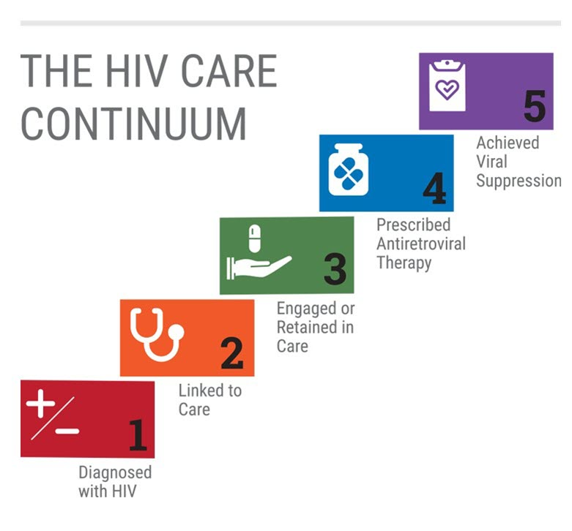
80

Slide 81

PMTCT
CASCADE
New Staff Orientation
14th June, 2022.
Notes:
The highest HTS yield was recorded in community index while highest % contribution was from mobile services modality.

Slide 82
Overview of PMTCT
Prevention of mother to child transmission of HIV is the strategy for ensuring that HIV infection is not transmitted to an infant during pregnancy, delivery and lactation period.
01
Primary prevention of HIV infection in women of reproductive age and their partners.
.
PMTCT AIMS AT:
₀₂
Prevention of unintended pregnancies among women living with HIV.
03
Prevention of HIV transmission from women living with HIV to their infants.
.
04
Provision of appropriate treatment, care and support to women living with HIV, their children and families.

Slide 83
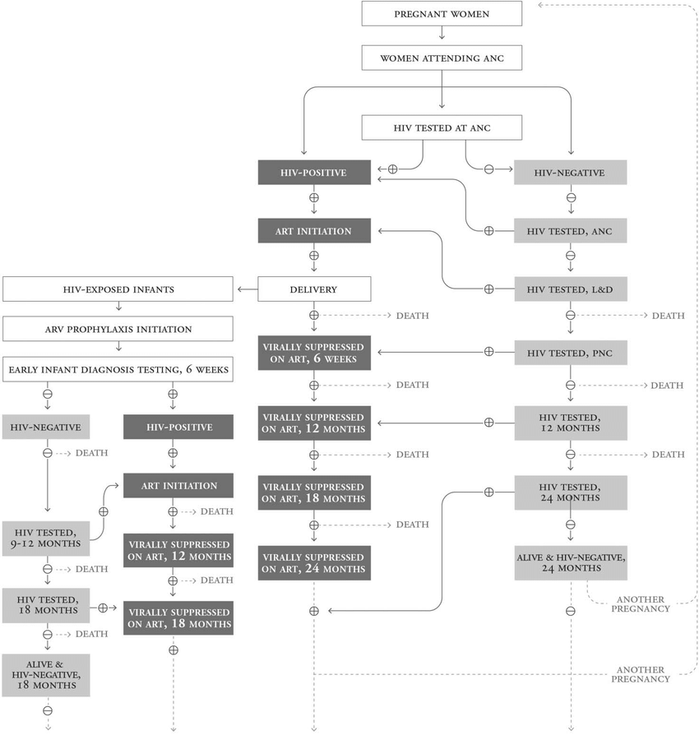
PMTCT Flow Chart
Notes:
Greater than 70% of HIV-Positive clients are identified in the Community

Slide 84

PMTCT Key Indicators
Notes:
Greater than 70% of HIV-Positive clients are identified in the Community

Slide 85


PMTCT_STAT
Description
Denominator
Numerator
Percentage of pregnant women with known HIV status at antenatal care (includes those who already knew their HIV status prior to ANC)
Number of new ANC clients in the reporting period
Number of pregnant women with known HIV status at first antenatal care visit (includes those who already knew their HIV status prior to ANC1)
Notes:
Greater than 70% of HIV-Positive clients are identified in the Community

Slide 86
PMTCT_STAT
Data Source / Reporting
Data Quality
Disaggregation
ANC Register.
PMTCT HTS_Register
Reported Quarterly.
Numerator ≤ Denominator. i.e % should not be greater than 100%
Status and age:
5-year age band
Known Positive
Newly tested Positive
New Negatives.
Notes:
Greater than 70% of HIV-Positive clients are identified in the Community

Slide 87
PMTCT_ART
Description
Denominator
Numerator
Percentage of HIV-positive pregnant women who received ART to reduce the risk of mother-to-child-transmission (MTCT) during pregnancy.
Number of pregnant women with known HIV positive status at first antenatal care visit.
Number of HIV-positive pregnant women who received ART to reduce the risk of mother-to-child-transmission during pregnancy.
Notes:
Greater than 70% of HIV-Positive clients are identified in the Community

Slide 88
PMTCT_ART
Data Source / Reporting
Data Quality
Disaggregation
Age and Maternal regimen type:
5-year age band
New on ART
Previously on ART
PMTCT ART Register.
Reported Quarterly
PMTCT_STAT_POS ≥ PMTCT_ART.
Notes:
Greater than 70% of HIV-Positive clients are identified in the Community

Slide 89
PMTCT_EID
Description
Denominator
Numerator
Percentage of infants born to HIV-positive women who received a first virologic HIV test (sample collected) by 12 months of age.
PMTCT_STAT_POS + HTS_TST_POS from the Post ANC1: Pregnancy/L&D/BF modality.
Number of infants born to HIV Positive women who had a first virologic HIV test (sample collected) by 12 months of age during the reporting period.
Notes:
Greater than 70% of HIV-Positive clients are identified in the Community

Slide 90
PMTCT_EID
Data Source / Reporting
Disaggregation
Data Quality
Denominator is a proxy denominator, numerator can be greater, equal to or less than the denominator.
Emphasis has been placed on the fact that infant’s samples should be collected at >2months rather than 2-12months.
Infant Test by Age at Sample Collection :
< 2 months
2-12 months
Child Follow-up Register.
Reported Quarterly
Notes:
Greater than 70% of HIV-Positive clients are identified in the Community

Slide 91
PMTCT_HEI_POS
Description
Denominator
Numerator
Number of HIV-infected infants identified in the reporting period, whose diagnostic sample was collected by 12 months of age.
N/A
Number of HIV-infected infants identified in the reporting period, whose diagnostic sample was collected by 12 months of age.
Notes:
Greater than 70% of HIV-Positive clients are identified in the Community

Slide 92
PMTCT_HEI_POS
Data Source / Reporting
Data Quality
Disaggregation
PMTCT_HEI_POS_ART ≤ PMTCT_HEI_POS
PMTCT_HEI_POS ≥ TX_NEW <1
Infant age at virologic sample collection, for positive infants:
< 2 months
2-12 months
Child Follow-up Register.
Reported Quarterly
Notes:
Greater than 70% of HIV-Positive clients are identified in the Community

Slide 93
PMTCT_FO
Description
Denominator
Numerator
Percentage of final outcomes among HIV exposed infants registered in a birth cohort.
Number of HIV-exposed infants with a documented outcome by 18 months of age disaggregated by outcome type.
Number of HIV-exposed infants who were born 24 months prior to the reporting period and registered in the birth cohort.
Notes:
Greater than 70% of HIV-Positive clients are identified in the Community

Slide 94
PMTCT_FO
Data Source / Reporting
Data Quality
Disaggregation
Outcome Type:
HIV-infected
HIV-uninfected
HIV-final status unknown
Died without status known.
Child Follow-up Register.
Reported Annually
Numerator = Denominator. If all outcomes are known regardless of the outcome type
Notes:
Greater than 70% of HIV-Positive clients are identified in the Community

Slide 95
Career Progression Plan

Slide 96




Data Assistant
Strategic Information department
Tech skill
Non-tech skill

Slide 97

Public Health World
Epidemiology
Biostatistics
Environmental Health
Health Policy
M&E etc
Strategic
Information
ICT World
Data Professions
Software Engineering and Development
Networking and Infrastructure

Slide 98




Data Professions
Data Engineering
Data Analytics
Roles
Data architecture
Design, store, manage data in data repository
ETL data from sources
Skills
Good knowledge of programming, systems, and technology architecture
In-depth understanding of relational database and non-relational data stores
Roles
Translate data and numbers
Inspect and clean data
Apply statistics to mine data, and identify patterns
Visualize data and present finds
Skills
Spreadsheet, Writing queries, statistical tools, visualization
Some programming skill
Data Science
Roles
Analyze data for actionable insights
Create predictive models by training on past data using machine learning and deep learning
Skills
Mathematics and Statistics
programming language, databases, building data models
Domain Knowledge

Slide 99

Languages and Tools Used by Data Professionals
Languages
Querying Languages for accessing and manipulating data in databases – SQL
Programming Languages for developing applications and controlling application behavior – Python, R, Java
Shell and Scripting Languages for repetitive and time-consuming operational tasks – Unix/Linux, PowerShell
Tools
Data Repository Databases, Data Warehouses, Big Data Stores, Data lakes, Data Pipe
DBMS MySQL, AZURE SQL, REDis, MongoDB, Cassandra, NEO4J
Spreadsheets MS Excel, Google Sheets
Analysis Tools Jupiter Notebook, Google Notebook, R Studio
Statistical Tools STATA, SPSS
Visualization Power Bi, Tableau

Slide 100
Software Engineering and Development
Web Development
Skill
Front End -- HTML, CSS, JavaScript, React, Angular, and Vue
Backend -- PHP, Node. JS, Java, Python etc.
Understand UX
Mobile App
Development
Skill
Front End -- HTML, CSS, JavaScript, ReactNative, Flutter
Backend -- PHP, Node. JS, Java, Python etc.
Understand UX
Cloud Engineering
Skill
Design, implement, and manage cloud-based systems for businesses
Develop and implement cloud-applications, migrate existing on-premise applications to the cloud, and debug cloud stacks
DevOps
Skill
Application and infrastructure planning, testing and development
Maintaining CI,CD Pipelines
Automation Implementation
On-call, incident response and incident management
Monitoring

Slide 101
Other Non-Coding ICT Fields
Network and Infrastructure (CompTIA A+,N+,S+, Linux+, CCNA)
Digital Marketing
.
•UI/UX
Product Management
Project Management

Slide 102








Health Information World
1
3
Public Health Informatician
Health IT
Area of IT involving the design, development, creation, use, and maintenance of information systems for the healthcare industry. (EHR, PHR, HIE, PACS)
Design, Develop, Implement, and Integrate Health Information systems to support public health programs. (EMR, LIS, NOMIS, DHIS2, NDR, Mobile Apps)
2
4
Medical Coder
Health Information Management
medical coder translates details from a patient's medical documents, such as physician's notes, lab reports, procedures, and diagnoses, into universal medical codes to maintain accurate medical records. (ICD, CPT, SNOMED, RXNORM).
Health records management involves the collection, organization, and maintenance of patient medical records and other healthcare-related information

